Slide 1
Big Mountain Pricing Analysis Report

Slide 2
Problem identification
What opportunities exist for Big Mountain Resort to gain $1,540,000 in additional revenue in the upcoming season by a) increasing ticket price and/or b) reducing costs?

Slide 3
Strategies evaluated
Raise ticket price.
Permanently close up to 10 of the least used runs.
Increase the vertical drop by adding a run to a point 150 feet lower down and installing an additional chair lift.
Increase vertical drop as well as adding 2 acres of snow making cover.
Increase the longest run by 0.2 mile to boast 3.5 miles length, requiring an additional snow making coverage of 4 acres.

Slide 4
Recommendations
Raise ticket price from $81.00 to about $96.
Increases revenue by $26,023,000 per season.
Close the least popular run.
Would not affect pricing, but contingent on savings and costs.

Slide 5
Modeling results
Sample size: 277 resorts
Train/test split: 70% training, 30% testing
Models compared:
Ordinary Least Squares regression with 8 strongest predictors
MAE in test data = 11.79
Random Forest regression
MAE in test data = 9.54
Model selected: Random Forest

Slide 6
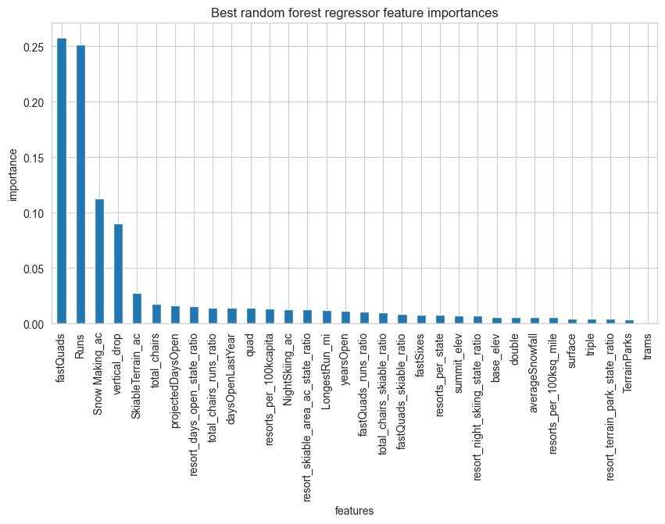
Strongest predictors
Fast quads
Number of runs
Snowmaking area
Vertical drop

Slide 7
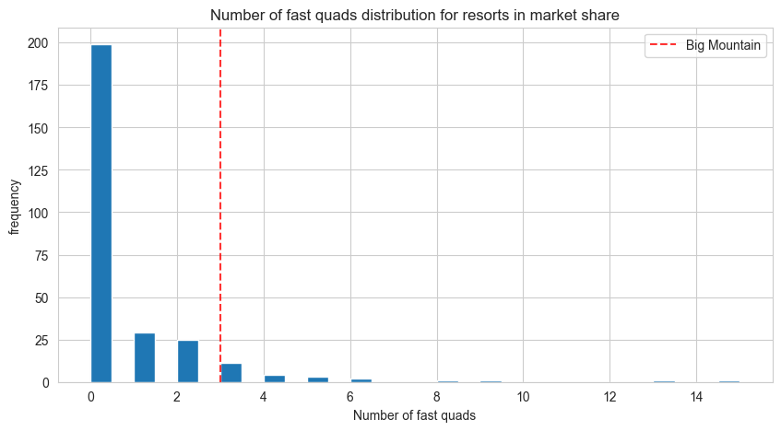
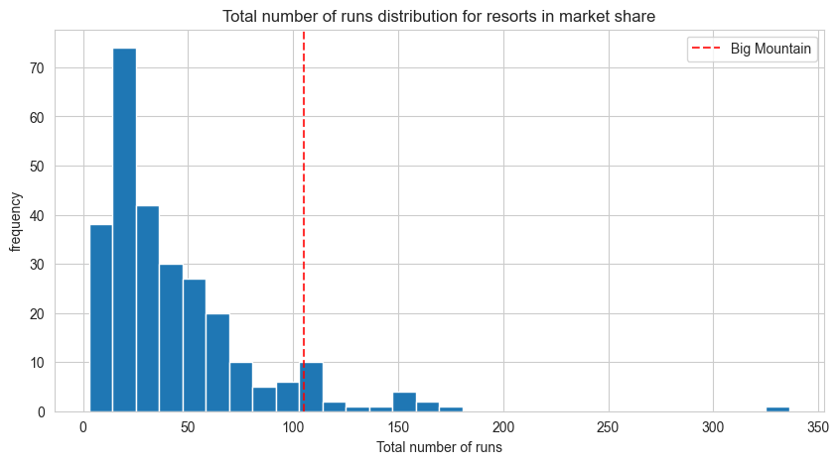
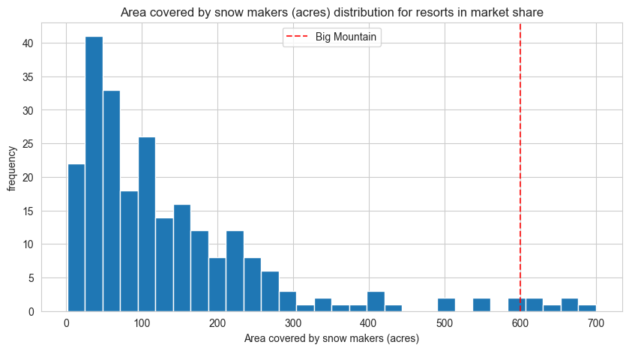
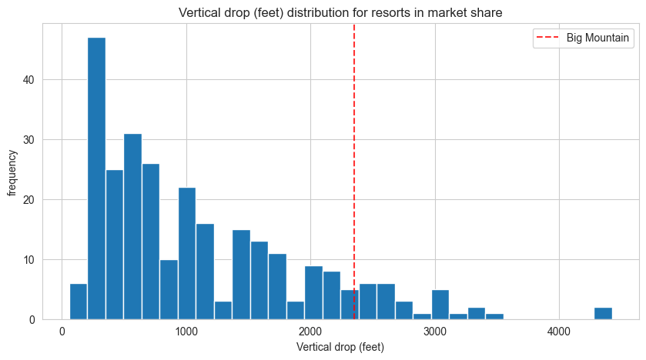
Big Mountain stands out in these features

Slide 8
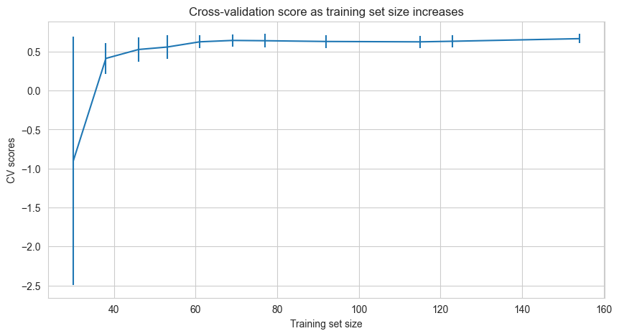
Sample size validation
Amount of data was adequate

Slide 9
Summary and conclusion
The suggested pricing change from $81 to $96 would increase revenue by $26,023,000 per season.
This strategy is supported because Big Mountain is already at the extreme upper range of the four features that were notably the most important predictors in the pricing model: Fast Quads, number of runs, snowmaking area, and vertical drop.
Highlighting these features in advertising material is highly recommended.

